Slide 1
An introduction to Student Finance 2023-24
To find out more about first-class teaching at Huddersfield, visit hud.ac/why-huddersfield.

Slide 2
What we’ll cover
1) What support is available?
2) How do you access it?
3) When and how to repay?
4) How to manage your money?
Student Finance England provides financial support to students entering higher education in the UK, on behalf of the UK government.
https://www.gov.uk/student-finance

Slide 3
What support can you get?

Slide 4
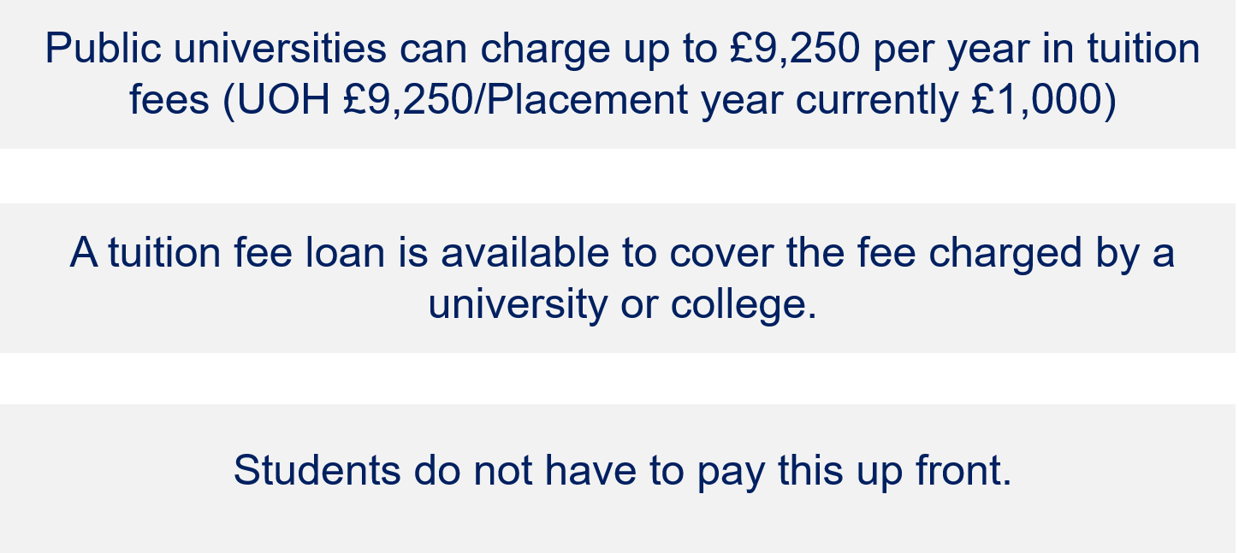
Tuition Fees

Slide 5
Tuition Fee Loans
These don’t depend on your household income or circumstances – you’ll get whatever the university charges for tuition fees (up to £9,250).
Your tuition fee loan will be paid directly to your university at the start of each term.
Your tuition fee loan is repayable, but only after you’ve graduated and are earning over £25,000 per year.

Slide 6
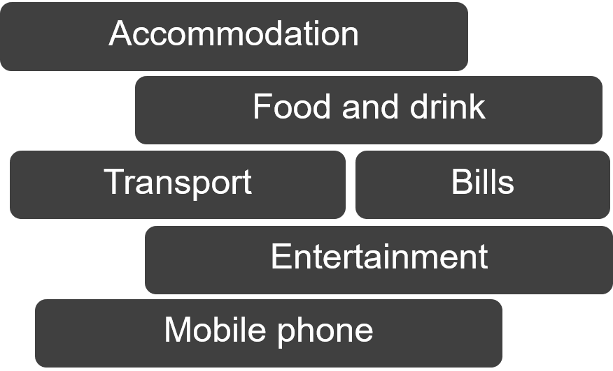
Maintenance Loans
A loan paid directly to the student in 3 instalments across the year, to help with living costs while at university.

Slide 7
Maintenance Loans: how much?
All eligible students can get some support towards living costs and this is paid into your bank account each term.
The amount of maintenance loan you can get depends on where you live and study, as well as your household income.
Maintenance loans have to be paid back but not until you’ve left university and your income is over £25,000 a year.

Slide 8
Maintenance Loan thresholds 2022-23
Household Income | Home | Elsewhere | London
£25,000 & under | £8,171 | £9,706 | £12,667
£30,000 | £7,484 | £9,012 | £11,961
£35,000 | £6,796 | £8,318 | £11,255
£40,000 | £6,108 | £7,623 | £10,549
£45,000 | £5,420 | £6,929 | £9,843
£50,000 | £4,733 | £6,234 | £9,136
£55,000 | £4,045 | £5,540 | £8,430
£60,000 | £3,597 | £4,733 | £7,724
£65,000 | £3,597 | £4,524 | £7,018
£70,000 | £3,597 | £4,524 | £6,308
Figures currently not available for 2023 entry.

Slide 9
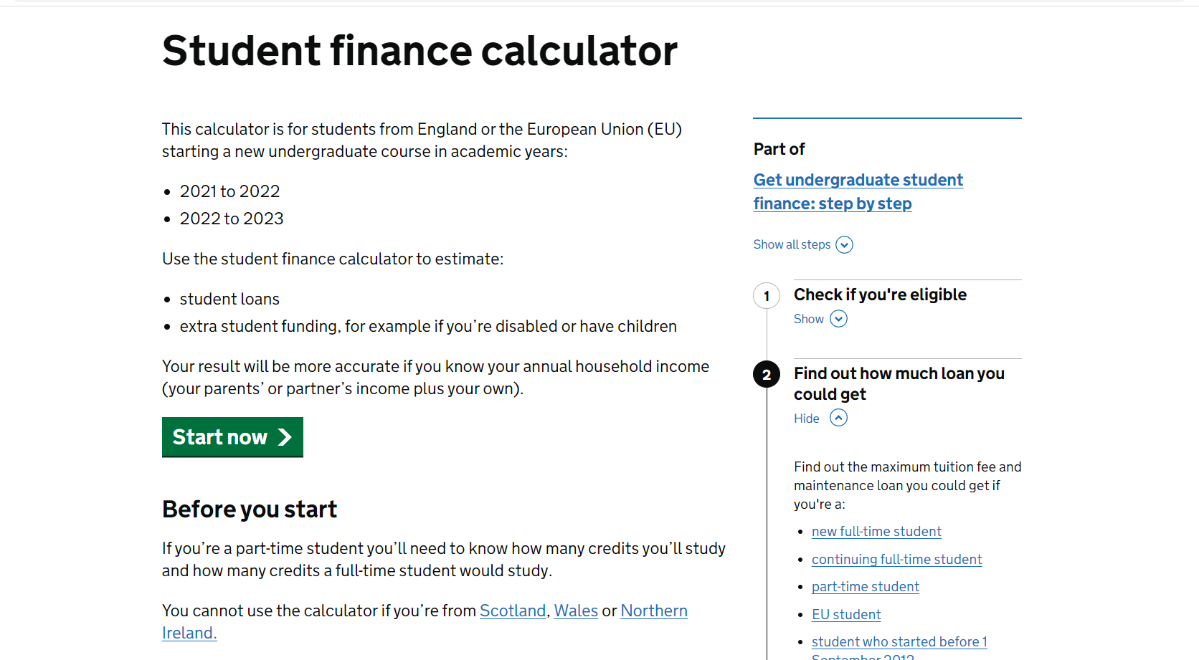
Online Student Finance Calculator
The online calculator
provides an assessment of individual entitlement

Slide 10
Additional support
NHS Courses
Extra, non-repayable funding available for eligible NHS courses:
NHS Learning Support Fund (NHS LSF)
Bursaries and scholarships provide additional financial support
from your university, based on circumstances such as household
income or academic performance.
Additional funding and support available (finance, accommodation
and wellbeing support) UCAS guide for individual needs
Disabled Students Allowance.
www.gov.uk/disabled-students-allowances-dsas
Bursaries and Scholarships
Care-experienced or estranged
Disability Support

Slide 11
Nursing, midwifery and health profession courses
NHS Learning Support Fund
Additional non-repayable Training Grant of £5,000 a year*
£1,000 Specialist Subject Payments – disciplines that struggle to recruit e.g. mental health
£2,000 Parental Support - additional childcare allowance
Additional funding: Travel and Dual Accommodation Expenses and Exceptional Support Fund
Additional
funding available
for eligible
students
Further details and eligibility available at *Figs. subject to change for 2023 entry
www.nhsbsa.nhs.uk/nhs-learning-support-fund

Slide 12
University of Huddersfield Scholarships
Plus subject specific scholarships available

Slide 13
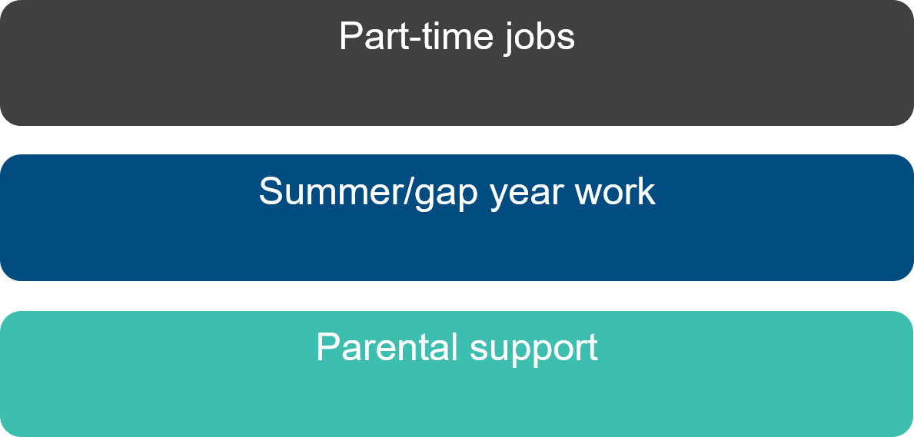
Other sources of income

Slide 14
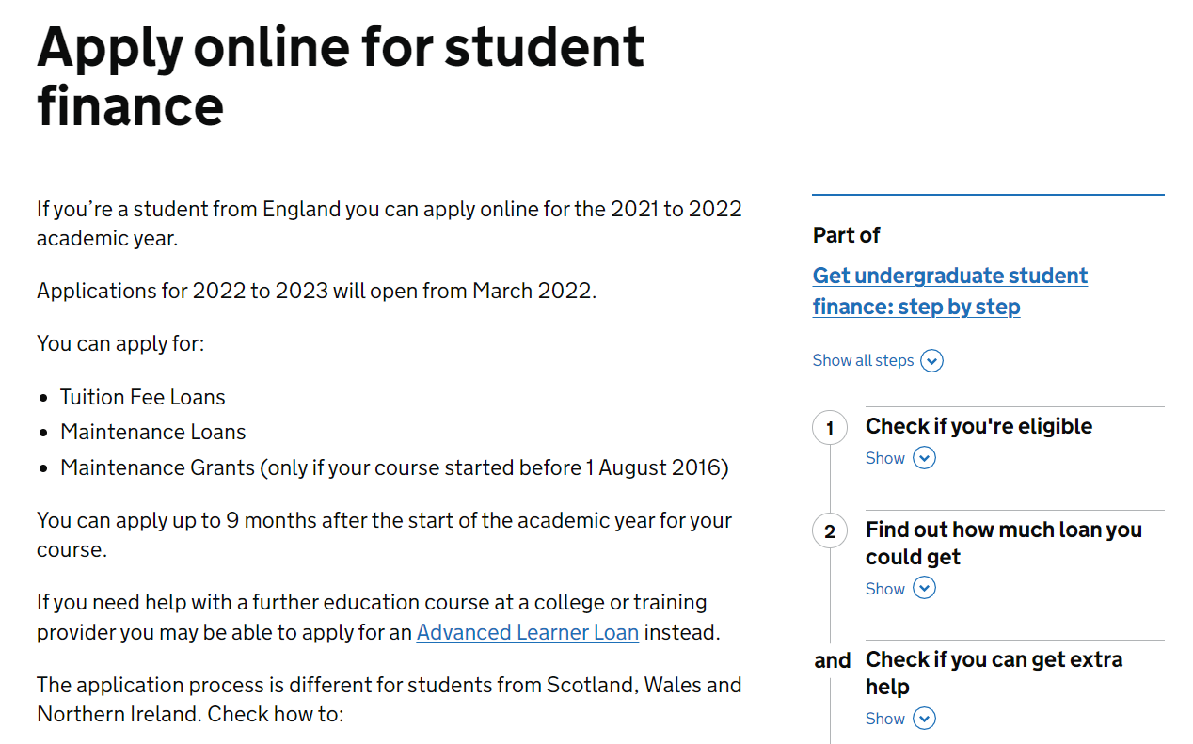
How to apply for student finance
Apply online between March and May – don’t miss the deadline (end of May)!
www.gov.uk/apply-online-for-student-finance
Students don’t need a confirmed place at university to apply for student finance – simply state preferred course choice. This can be changed later.
SFE data: only 35% apply on time, not all with required evidence

Slide 15
When and how to repay
Monthly repayments begin the April after graduation but will not start until your
income exceeds £25,000. Pay 9% on earnings over £25,000
(e.g. on £28,000, pay 9% of £3,000 = £270 / 12 = £22.50 per month)
Your monthly repayments will be based on your earnings, not on your loan
amount. Deductions will be made from your pay through the HMRC tax
system. The loan interest rate will be set at RPI + 0%
If your income falls to £25,000 or below your repayments will stop. Any
outstanding loan balance will be cancelled 40 years after entering repayment.
+£25k

Slide 16
Student finance application video

Slide 17
Student budgeting tips
Budgeting tips
Plan a budget before starting university
Consider having two bank accounts (with the same bank) for bills and day to day spending www.ucas.com/finance/managing-money/quicker-way-get-student-account
Prioritise essential spending (accommodation, food, travel) before luxuries (going out etc.)
Consider extra sources of income (part-time work, parental support) before starting university.
Re-apply for student finance for each year you’re at university.

Slide 18
Typical student expenditure
Types of expenditure | Estimated cost
Accommodation | Average cost - £147 per week, but varies massively from < £100 to > £200 (including bills).
Food, drink and essentials | Expect to pay £30-£50 a week on your shopping.
Entertainment | Buy an NUS TOTUM + Age ID card (£14.99 per year/£24.99 3 years) for savings on shopping, restaurants, cinema (save on average £12.75 a week)
Text books and course materials | Text books can be expensive (e.g. £30 each), but you can borrow books from the library or pick up discounted and second-hand books on campus.

Slide 19
Where to find out more

Slide 20
Key things to remember
Tuition fees can be covered in full by a tuition fee loan.
Maintenance loans are available to help cover living costs and the amount you receive depends on your household income and circumstances.
Additional sources of income, including part-time jobs and parental support can also help cover living costs.
Loan repayments don’t begin until you’ve graduated and are earning over £25,000. Repayments are based on your earnings, not on borrowings.

Slide 21
Open Days 2022 Saturday 2nd July Saturday 24th September (online) Saturday 8th October Saturday 29th October Saturday 19th November http://www.hud.ac.uk/open-days/
*To find out more about placement opportunities at Huddersfield, visit hud.ac/placements

